Slide 1
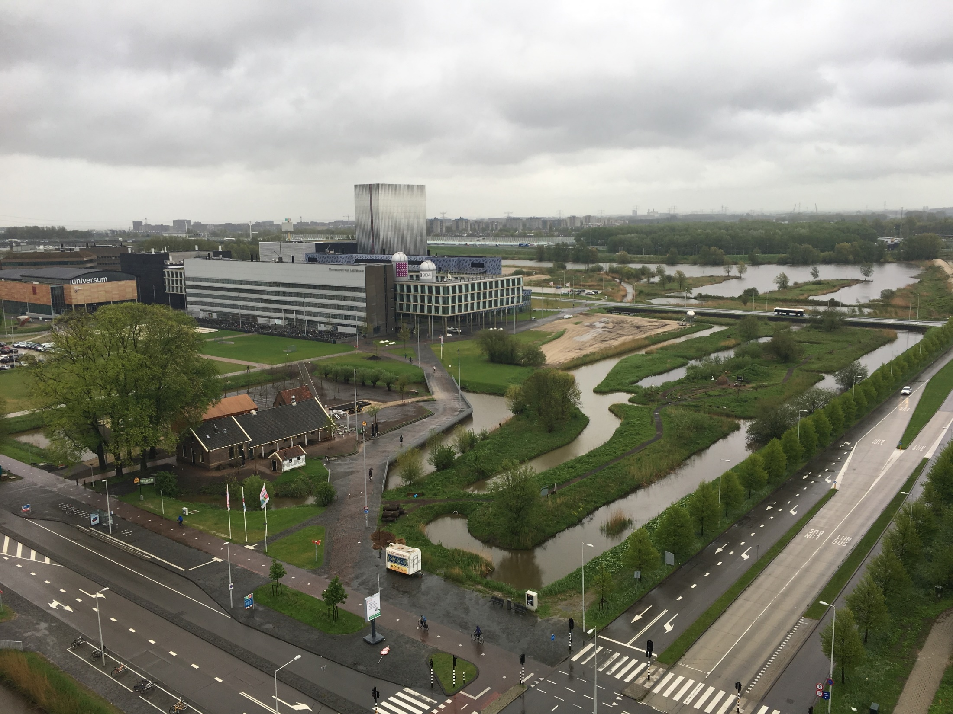

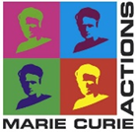
Hundred Young Academic Leaders Program of Nankai University
南开大学“百名青年学科带头人培养计划” 面 试 报 告
Georgios A. Siviloglou

Slide 2
Basic personal information
个人简介
Basic information
Place of birth: Athens, Greece
Date of birth: 27.09.1978
Education
1996 – 2003 NTUA, Greece Diploma of Electrical Engineering
2004 – 2010 CREOL, USA PhD in Optics
Research
2010 – 2014 MIT, USA Postdoc and Research Scientist
2014 – 2018 UvA, Holland Postdoc and Marie Curie Fellow
荷兰阿姆斯特丹大学玛丽居里Fellow

Slide 3

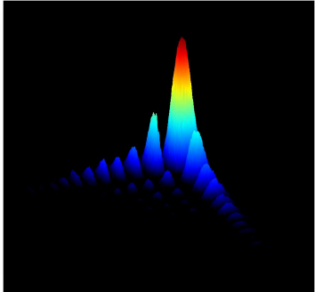
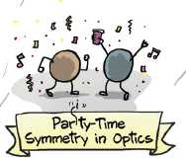
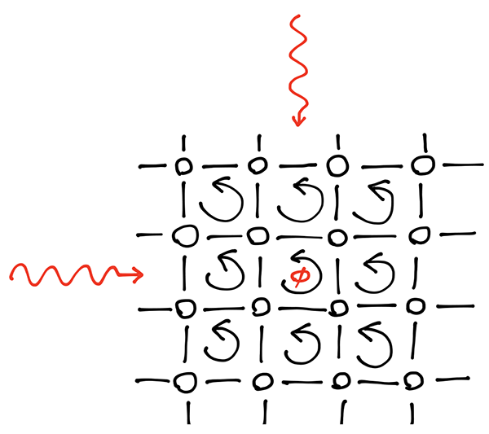
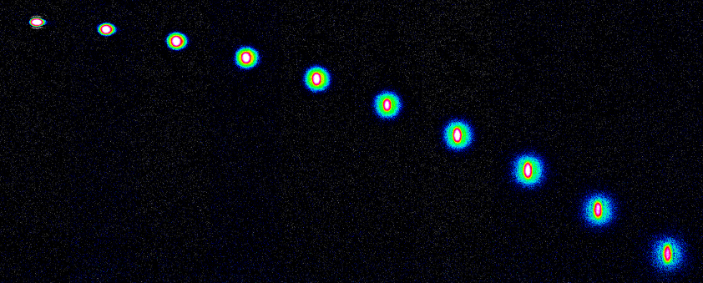
Main research accomplishments
主要学术成果
7 papers in the top 1% in the field of Physics (ISI Web of Science)
Self-bending Airy beams (>2000 citations)
𝒫𝒯-symmetry (1005 citations)
Hofstadter Hamiltonian (citations 449)
Quantum gases of strontium
7篇文章成为SCI 排名1%的高引论文

Slide 4

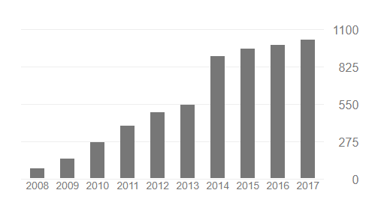
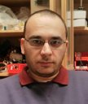
Publication summary
发表论文概况
18 + 1 (in preparation) peer-reviewed articles
Among them 6 Phys. Rev. Lett. and 1 Science
4 publications in Optics and Photonics News (published by OSA)
1 invited book chapter
Total citations > 4250
7 papers in the top 1% of physics
224 citations per paper
总引6000余次
他引4000余次
Citations per year

Slide 5
Publication list
J. Schachenmayer, D. M. Weld, H. Miyake, G. A. Siviloglou, W. Ketterle, and A. J. Daley, " Adiabatic cooling of bosons in lattices to magnetically ordered quantum states" Physical Review A 92, 041602(R) (2015). (ISI citations 5)
H. Miyake, G. A. Siviloglou, C. J. Kennedy, W. C. Burton, and W. Ketterle, "Realizing the Harper Hamiltonian with Laser-Assisted Tunneling in Optical Lattices" Physical Review Letters 111, 185302 (2013). (ISI citations 431)
C. J. Kennedy, G. A. Siviloglou, H. Miyake, W. C. Burton, and W. Ketterle, "Spin-Orbit Coupling and Spin Hall Effect for Neutral Atoms without Spin Flips" Physical Review Letters 111, 225301 (2013). (ISI citations 75)
H. Miyake, G. A. Siviloglou, G. Puentes, D. E. Pritchard, W. Ketterle, and D. M. Weld. "Bragg scattering as a probe of atomic wave functions and quantum phase transitions in optical lattices" Physical Review Letters 107, 175302 (2011). (ISI citations 37)
G. A. Siviloglou, J. Broky, A. Dogariu, and D. N. Christodoulides, "Observation of Accelerating Airy Beams" Physical Review Letters 99, 213901 (2007). (ISI citations 845)
P. Polynkin, M. Kolesik, J. V. Moloney, G. A. Siviloglou, D. N. Christodoulides, "Curved Plasma Channel Generation Using Ultraintense Airy Beams" Science 324, 229-232 (2009). (ISI citations 396)
A. Guo, G. J. Salamo, D. Duchesne, R. Morandotti, M. Volatier-Ravat, V. Aimez, G. A. Siviloglou, and D. N. Christodoulides, "Observation of PT-Symmetry Breaking in Complex Optical Potentials" Physical Review Letters 103, 093902 (2009). (ISI citations 948)
J. Shu, J. Lee, J. W. Fleischer, G. A. Siviloglou, and D. N. Christodoulides, "Diffusion-trapped Airy beams in photorefractive media" Physical Review Letters 104, 253904 (2010). (ISI citations 59)

Slide 6
Publication list
G. A. Siviloglou and D. N. Christodoulides, "Accelerating finite energy Airy beams" Optics Letters 32, 979-981 (2007). (ISI citations 692)
G. A. Siviloglou, J. Broky, A. Dogariu, and D. N. Christodoulides, "Ballistic dynamics of Airy beams" Optics Letters 33, 207-209 (2008). (ISI citations 213)
G. A. Siviloglou, K. G. Makris, R. Iwanow, R. Schiek, D. N. Christodoulides, G. I. Stegeman, Y. Min, and W. Sohler, "Observation of discrete quadratic surface solitons" Optics Express 14, 5508-5516 (2006). (ISI citations 67)
G. A. Siviloglou, S. Suntsov, R. El-Ganainy, R. Iwanow, G. I. Stegeman, D. N. Christodoulides, R. Morandotti, D. Modotto, A. Locatelli, C. De Angelis, F. Pozzi, C. R. Stanley, and M. Sorel,
"Enhanced third-order nonlinear effects in optical AlGaAs nanowires" Optics Express 14, 9377-9384 (2006). (ISI citations 42)
J. Broky, G. A. Siviloglou, A. Dogariu, and D. N. Christodoulides, "Self-healing properties of optical Airy beams" Optics Express 16, 12880-12891 (2008). (ISI citations 378)
S. Suntsov, K. G. Makris, G. A. Siviloglou, R. Iwanow, R. Schiek, D. N. Christodoulides, G. I. Stegeman, R. Morandotti, H. Yang, G. Salamo, M. Volatier, V. Aimez, R. Ares, M. Sorel, Y. Min, W. Sohler, X. S. Wang, A. Bezryadina, Z. G. Chen, "Observation of one- and two-dimensional discrete surface spatial solitons" Journal of Nonlin. Opt. Phys. & Mat. 16, 401-426 (2007). (Invited Paper) (ISI citations 33)
N. K. Efremidis, G. A. Siviloglou, and D. N. Christodoulides, "Exact X-wave solutions of the hyperbolic nonlinear Schrödinger equation with a supporting potential" Physics Letters A 373, 4073 (2009). (ISI citations 5)
T. J. Eichelkraut, G. A. Siviloglou, I. M. Besieris, and D. N. Christodoulides,
“Oblique Airy wave packets in bidispersive optical media”
Optics Letters 35, 3655 (2010). (ISI citations 18)

Slide 7
Publication list
N. Barbieri, M. Weidman, G. Katona, M. Baudelet, Z. Roth, E. Johnson, G. A. Siviloglou, D. N. Christodoulides, and M. Richardson, "Double helical laser beams based on interfering first-order Bessel beams" J. Opt. Soc. Am. A 28, 1462 (2011). (ISI citations 11)
M. S. Mills, G. A. Siviloglou, N. Efremidis, T. Graf, E. M. Wright, J. V. Moloney, D. N. Christodoulides, "Localized Waves with Spherical Harmonic Symmetries" Physical Review A 86.6 (2012). (ISI citations 4)

Slide 8
Other publications
Other publications
P. Polynkin, M. Kolesik, J. Moloney, G. A. Siviloglou, and D. Christodoulides,
“Extreme Nonlinear Optics with Ultra-Intense Self-Bending Airy Beams”
Optics and Photonics News, September 2010 (Invited publication)
P. Polynkin, M. Kolesik, J. Moloney, G. A. Siviloglou, and D. Christodoulides,
“Curved Plasma Channel Generation in Air Using Ultra-Intense Self-Bending Airy Beams”
Optics and Photonics News, Optics in 2009, December 2009
G. A. Siviloglou, J. Broky, A. Dogariu, and D. Christodoulides,
“Airy Beams: A New Class of Optical Waves”
Optics and Photonics News, Optics in 2008, December 2008
F. Pozzi, M. Sorel, G.A. Siviloglou, S. Suntsov, R. El-Ganainy, R. Iwanow, G.I. Stegeman,
D.N. Christodoulides, D. Modotto, A. Locatelli, C. De Angelis and R. Morandotti,
“Enhanced Third-Order Nonlinear Effects in Ultra-Compact AlGaAs Nanowires”
Optics and Photonics News, Optics in 2006, December 2006
Book chapter
Y. Hu, G. A. Siviloglou, P. Zhang, N. K. Efremidis, D. N. Christodoulides, and Z. Chen.
Self-accelerating Airy beams: generation, control, and applications.
In Nonlinear Photonics and Novel Optical Phenomena, pp. 1-46. Springer New York, 2012.

Slide 9
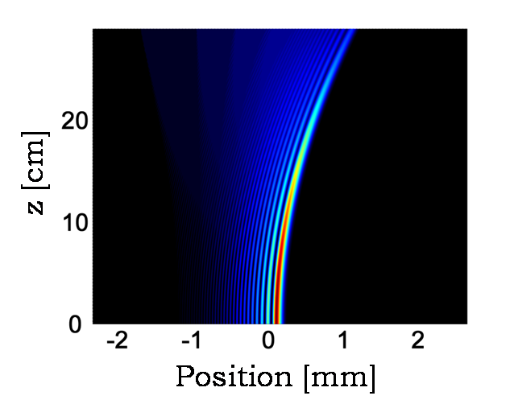
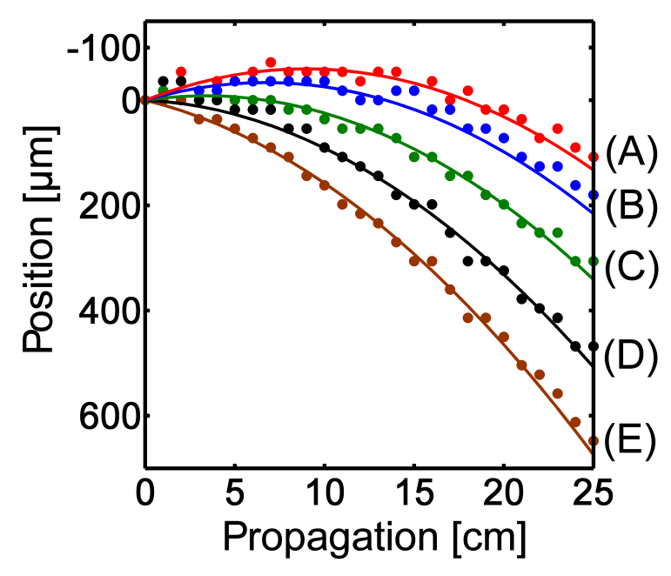
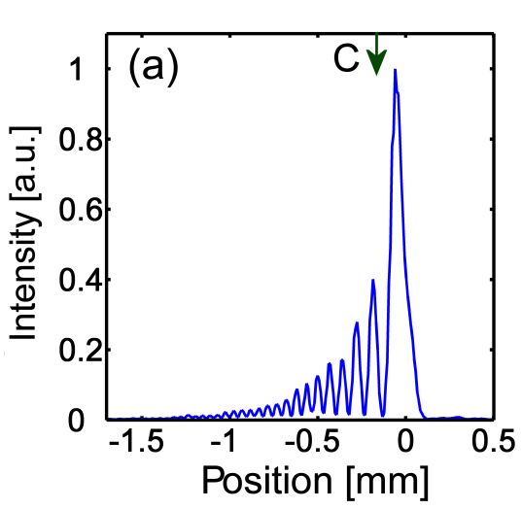
Optical Airy beams
主要学术贡献
国际上首次实现光学艾里光，开创了自加速光的研究
Beam propagation
Position of the beam maximum
G. A. Siviloglou and D. N. Christodoulides, Opt. Lett. 32, 979 (2007). (cited 878)
G. A. Siviloglou, J. Broky, A. Dogariu, and D. N. Christodoulides, Phys. Rev. Lett. 99, 213901 (2007) (cited 718)
G. A. Siviloglou, J. Broky, A. Dogariu, and D. N. Christodoulides, Opt. Lett. 33, 207 (2008) (cited 213)

Slide 10
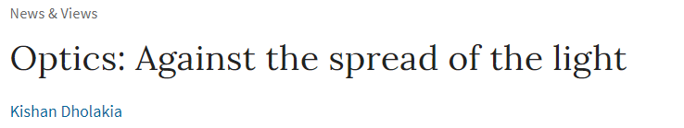


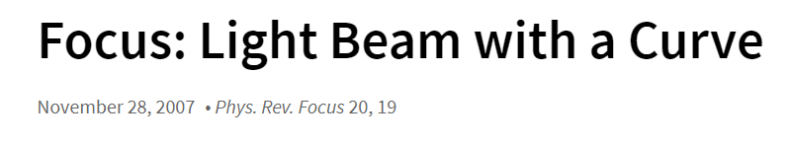
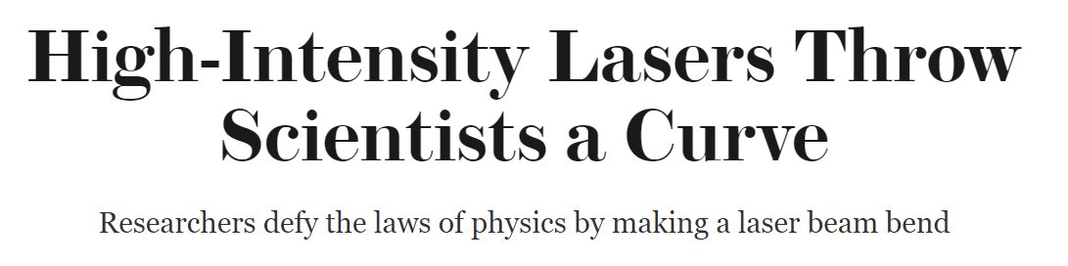


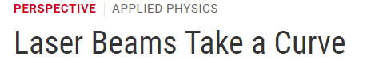
Optical Airy beams
一度成为诸多科学杂志新闻集锦
G. A. Siviloglou and D. N. Christodoulides, Opt. Lett. 32, 979 (2007).
G. A. Siviloglou, J. Broky, A. Dogariu, and D. N. Christodoulides, Phys. Rev. Lett. 99, 213901 (2007)
P. Polynkin, M. Kolesik, J. V. Moloney, G. A. Siviloglou, and D. N. Christodoulides, Science 324, 229 (2009) (cited 396)

Slide 11
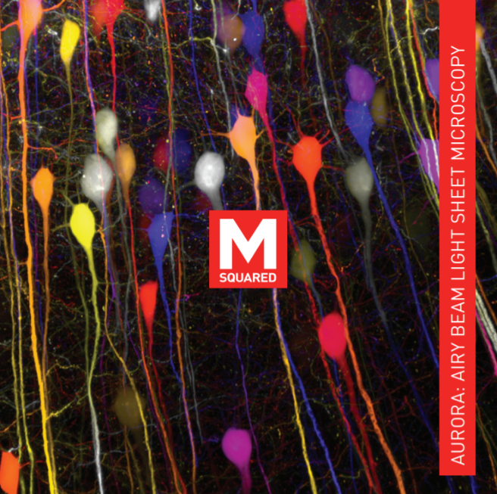
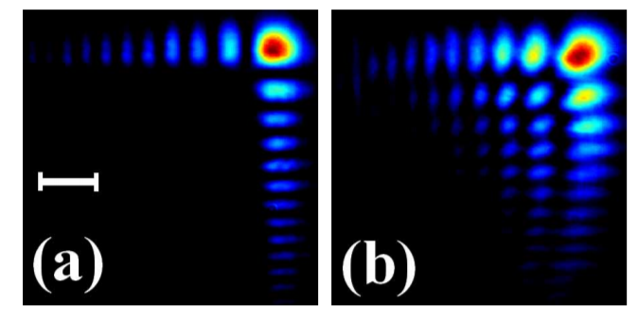
Why non-diffracting, self-bending Airy beams are important?
在多个领域得到广泛应用
Commercial Airy microscopy
Self-healing
500x faster than confocal microscopy
Robust even in biological tissue
D. Christodoulides, A. Dogariu, and G. Siviloglou United States Patent US 8,101,929 B1 (2012)
J. Broky, G. A. Siviloglou, A. Dogariu, and D. N. Christodoulides, Opt. Express 16, 12880 (2008) (cited 378)

Slide 12
主要学术贡献
From optics to ultracold quantum gases
从光学到超冷原子量子气体

Slide 13
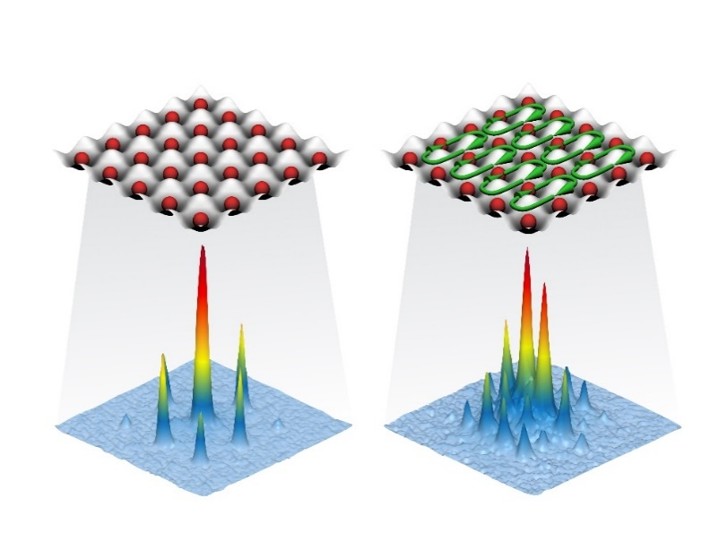
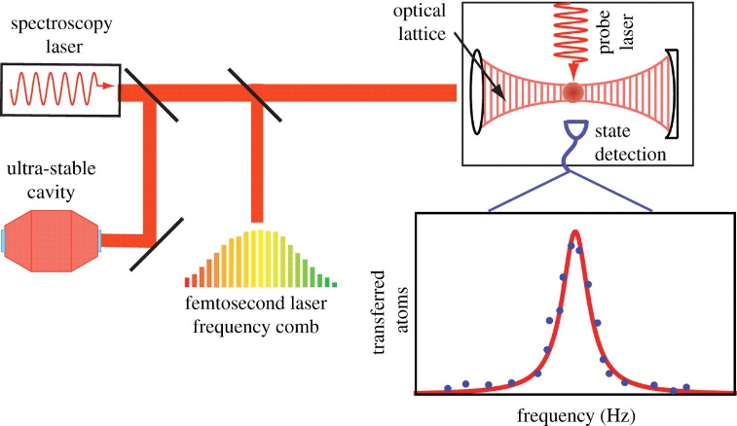
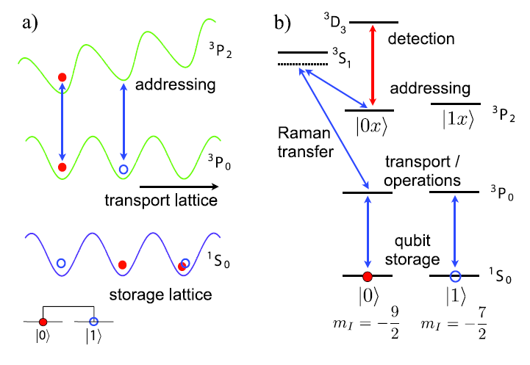
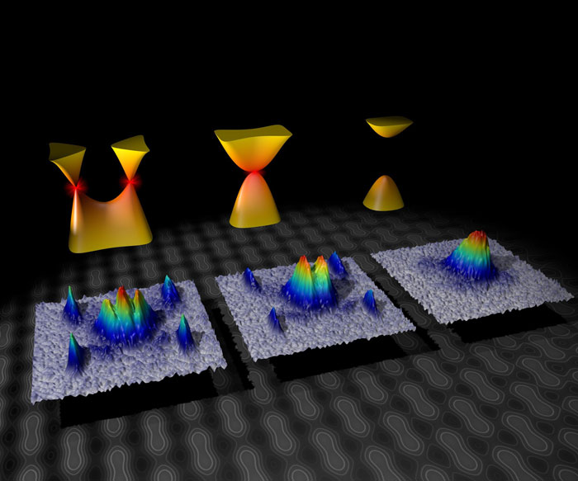
Applications and quantum simulation with ultracold atoms
超冷原子的量子模拟
Strong magnetic fields
Lattice clocks
Quantum
computing
Graphene physics

Slide 14
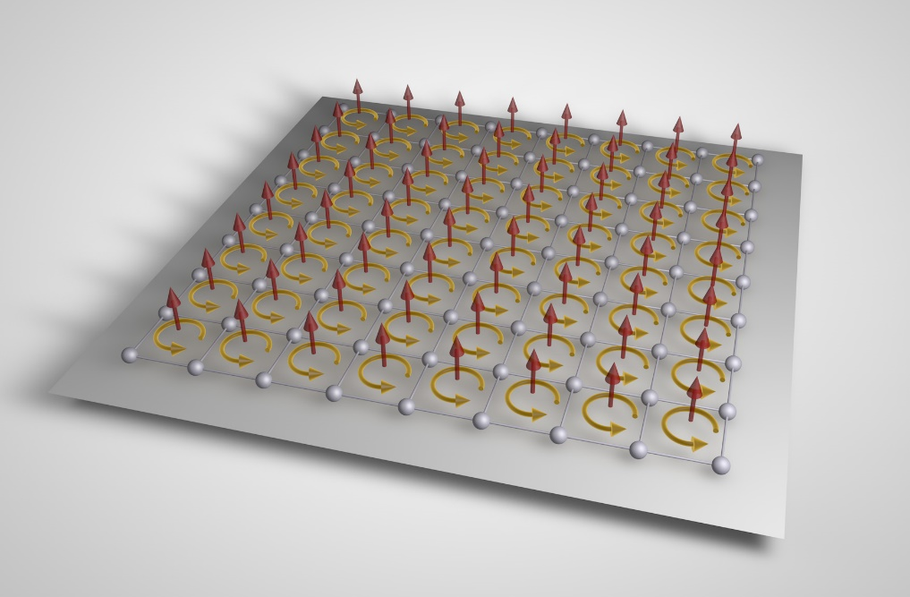

The Hofstadter-Harper Hamiltonian
国际上首次实现Hofstadter 哈密顿，具有像首次实现BEC的意义
Created for the first time the Hofstadter Hamiltonian in an atomic system
Hofstadter butterfly spectrum
MPQ
Previous experiments had less than one vortex per 1000 atoms
P. G. Harper, Proceedings of the Physical Society. Section A 68, 874 (1955)
D. R. Hofstadter, Phys. Rev. B 14, 2239 (1976)

Slide 15
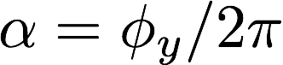
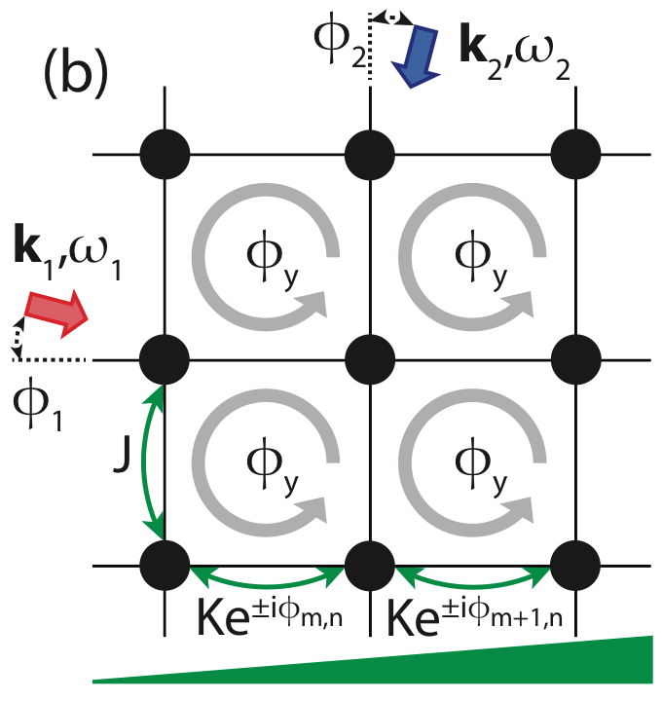
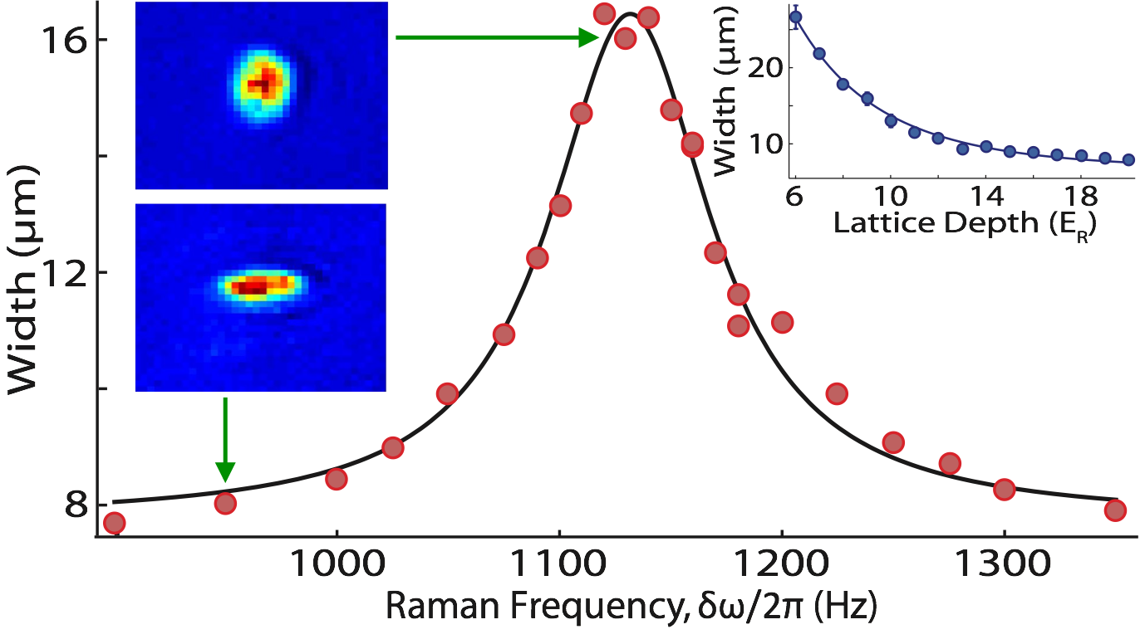
Strong synthetic fields for neutral atoms
实现中性原子的超强膺磁场
Larger width corresponds to stronger coupling
Scheme to induce complex tunneling
When ω2-ω1 = Δ resonant tunneling is established
M. Aidelsburger, M. Atala, M. Lohse, J. T. Barreiro, B. Paredes, and I. Bloch, Phys. Rev. Lett. 111, 185301 (2013)
H. Miyake, G. A. Siviloglou, C. J. Kennedy, W. C. Burton, and W. Ketterle, Phys. Rev. Lett. 111, 185302 (2013) (cited 431)
C. J. Kennedy, G. A. Siviloglou, H. Miyake, W. C. Burton, and W. Ketterle, Phys. Rev. Lett. 111, 225301 (2013) (cited 75)

Slide 16
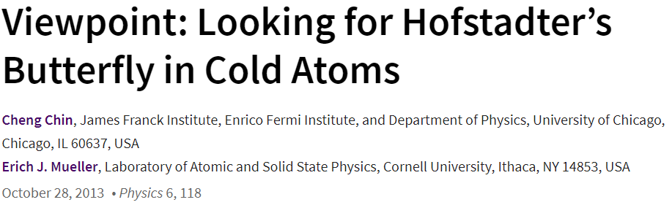
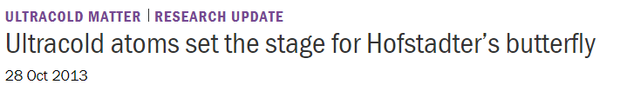

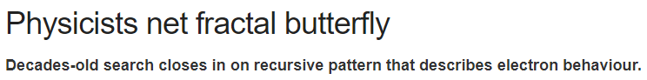
Artificial magnetic fields in an optical lattice
这一工作也一度成为诸多科学杂志新闻集锦

Slide 17
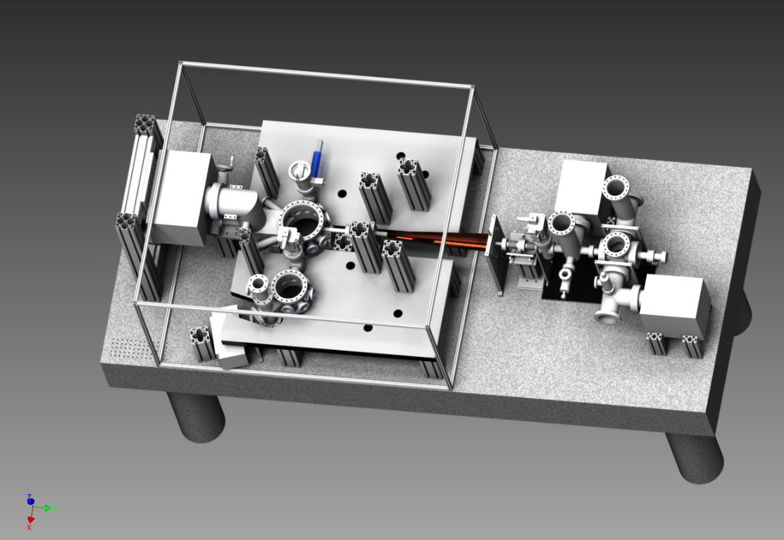


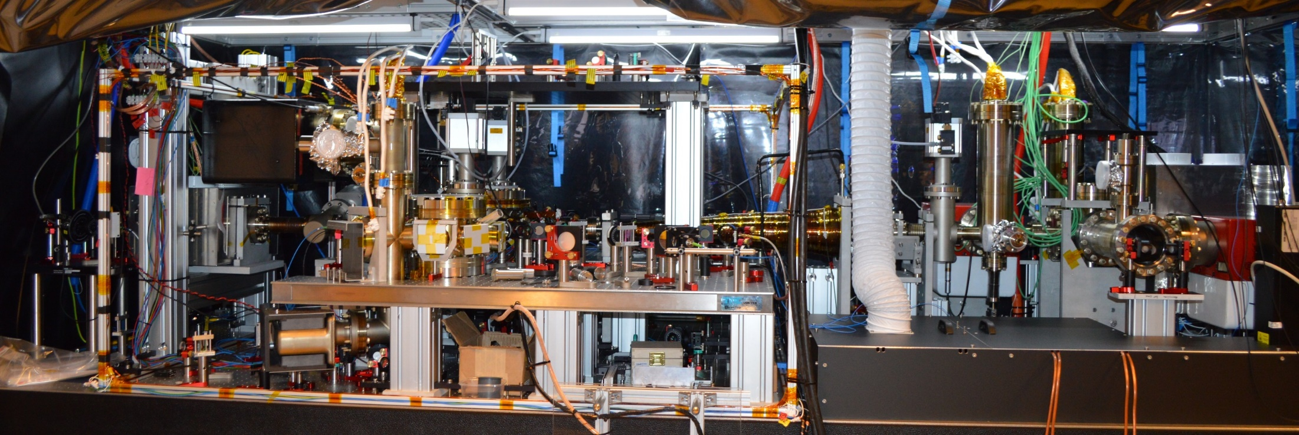
I designed and built a strontium quantum gas experiment
在阿姆斯特丹大学
建立了国际上少有的
锶原子量子气体实验

Slide 18
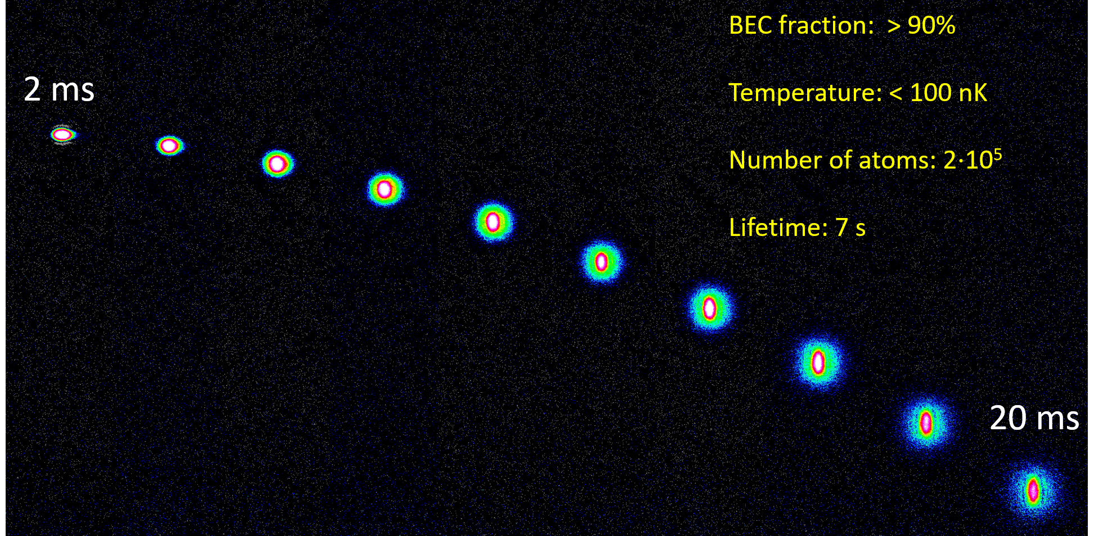
Free fall expansion of a ⁸⁴Sr BEC
We have created BEC and Fermi gases of strontium
(only few experiments in the world can do that)

Slide 19
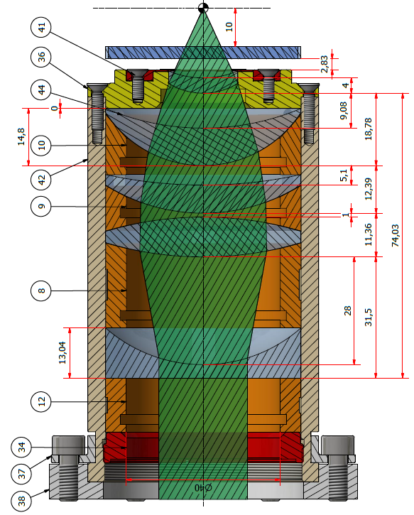
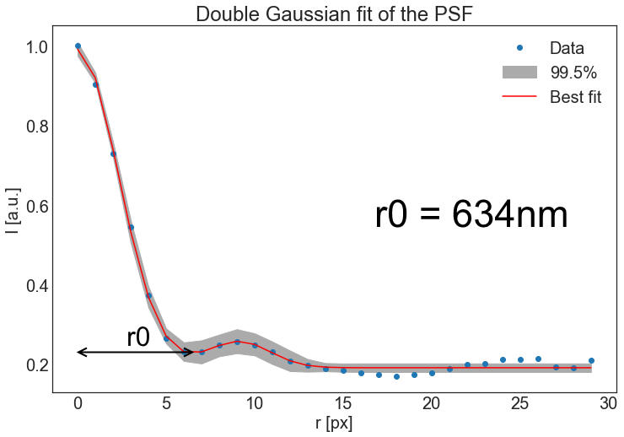
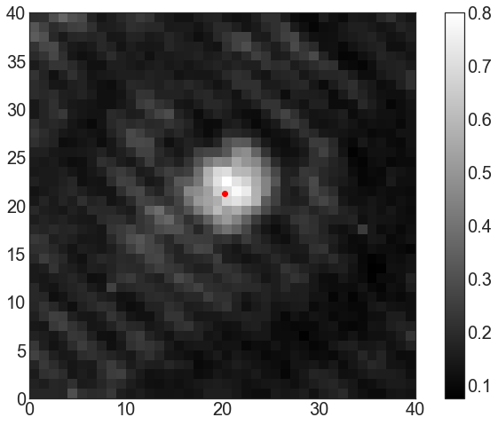
Microscope objective to resolve individual atoms in a lattice
I have designed a microscope capable of resolving individual lattice sites.
Notes:
6 randomly placed holes
2D Gaussian to find center
Double Gaussian fit
200nm holes

Slide 20
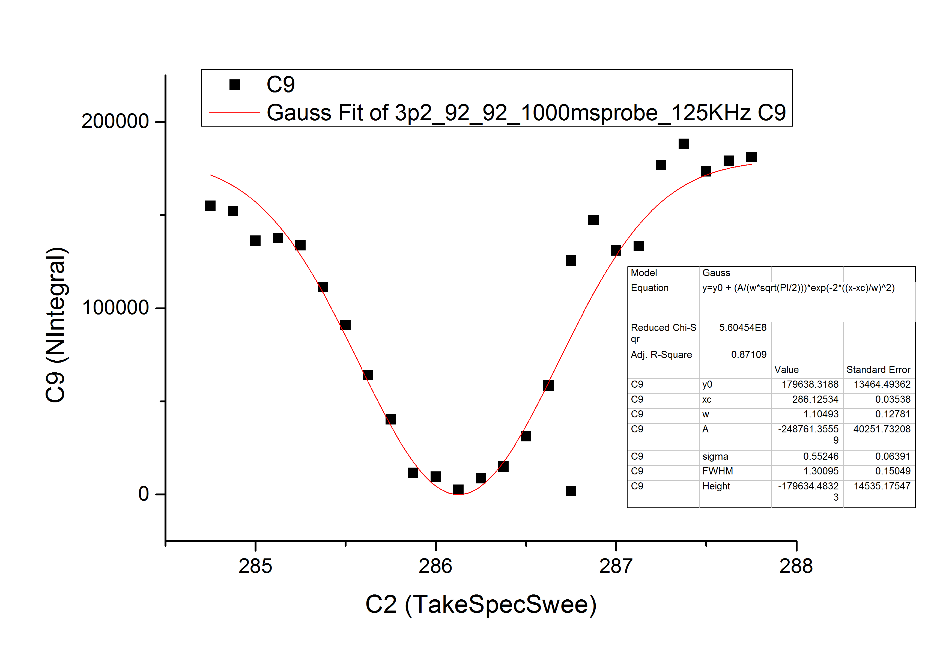
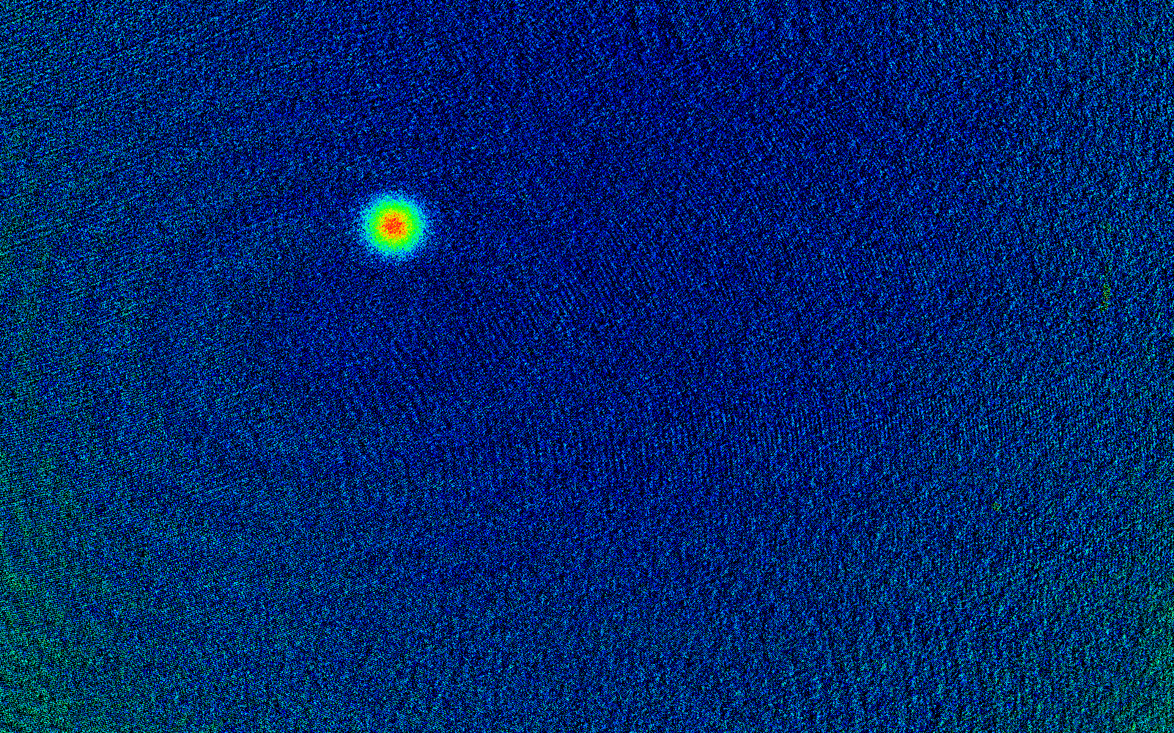
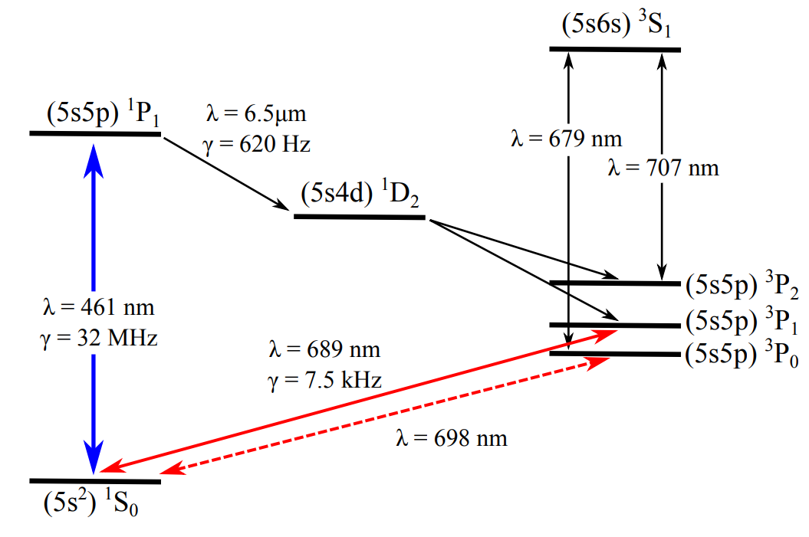
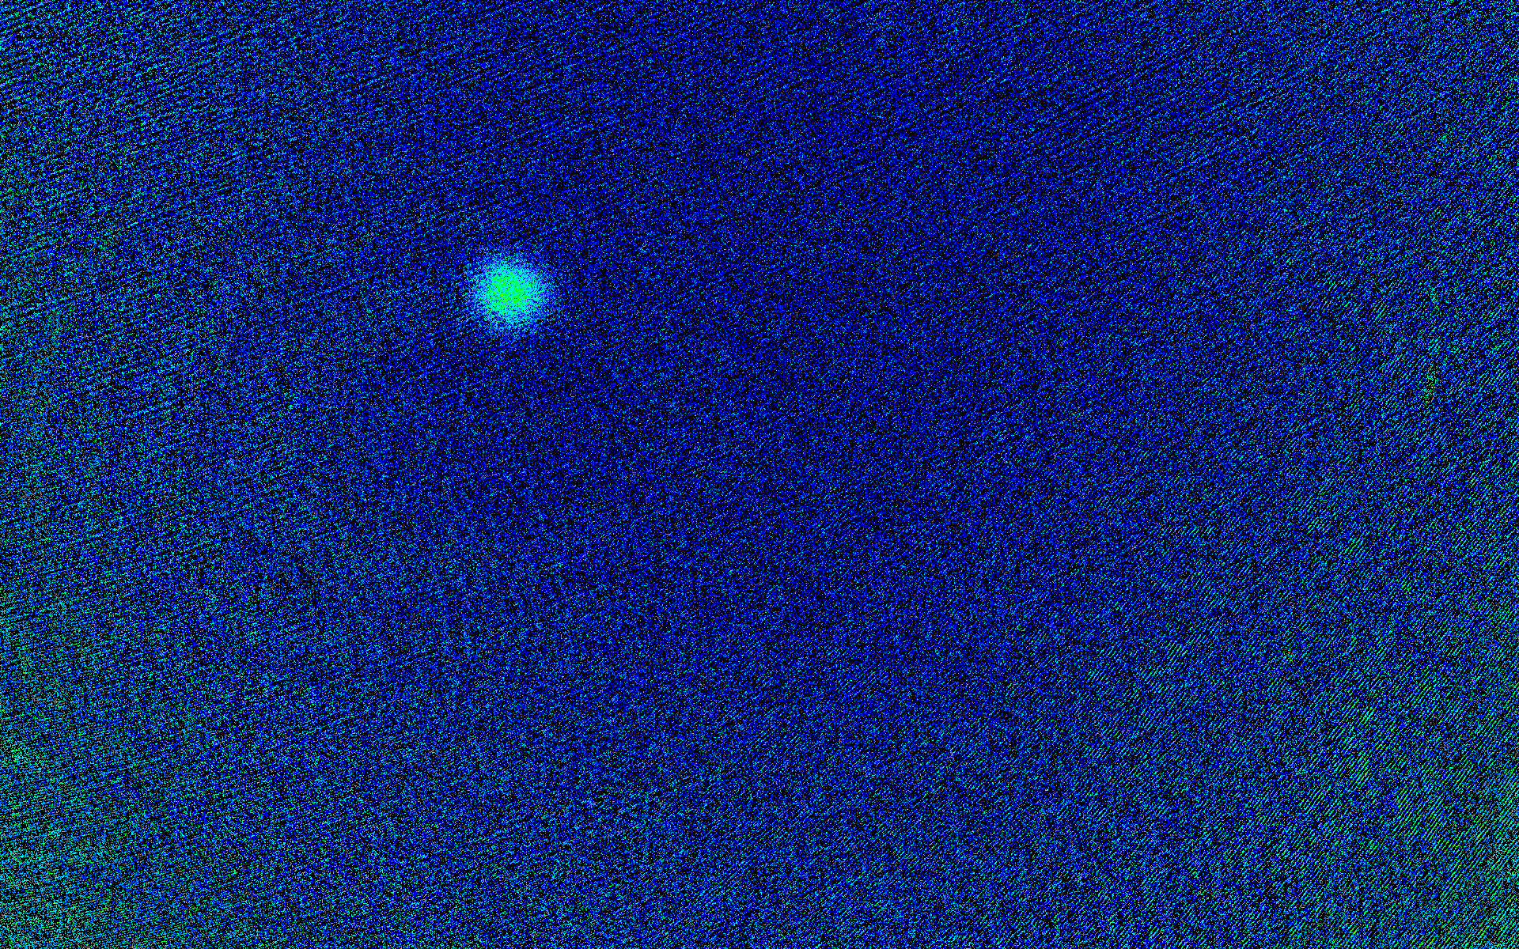
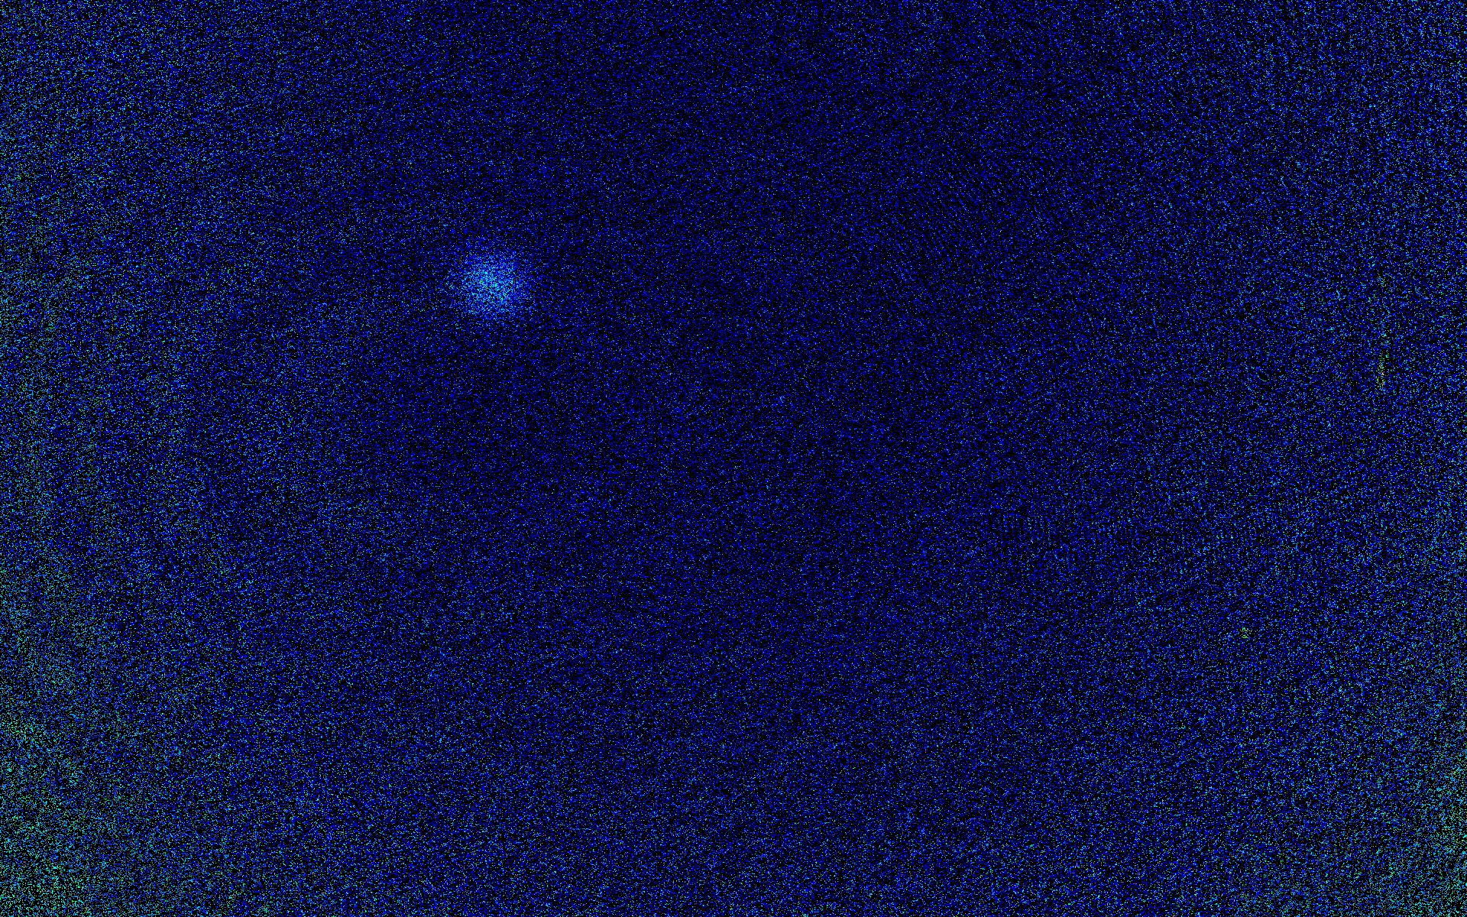
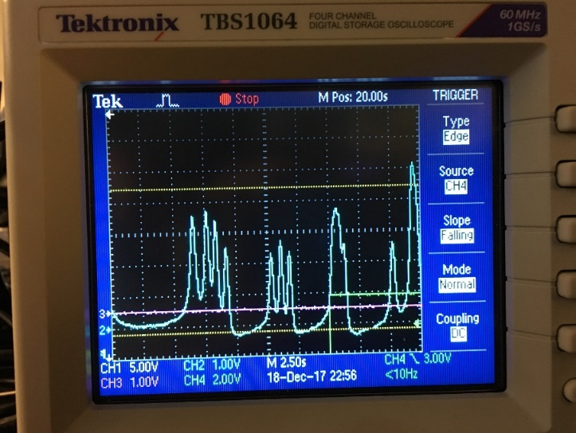
Spectroscopy for the ultranarrow transition ${{}_{ }^{1}S}_{0}{→{}_{ }^{3}{P_{2}}}_{ }$of ⁸⁷Sr
Number of atoms
AOM frequency (MHz)
?
First observation of the ultranarrow transition in fermionic Sr (<mHz)
Iodine spectroscopy
Observation of the ultranarrow doubly-forbidden transition in a Fermi gas of strontium (in preparation)
Notes:
6 randomly placed holes
2D Gaussian to find center
Double Gaussian fit
200nm holes

Slide 21
未来研究计划
What I want to achieve next

Slide 22
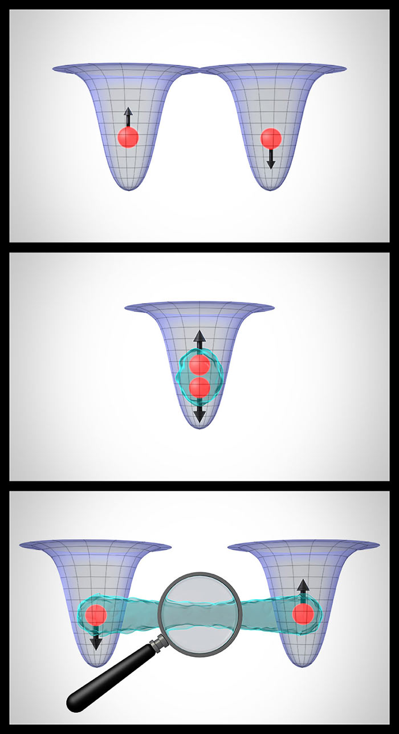
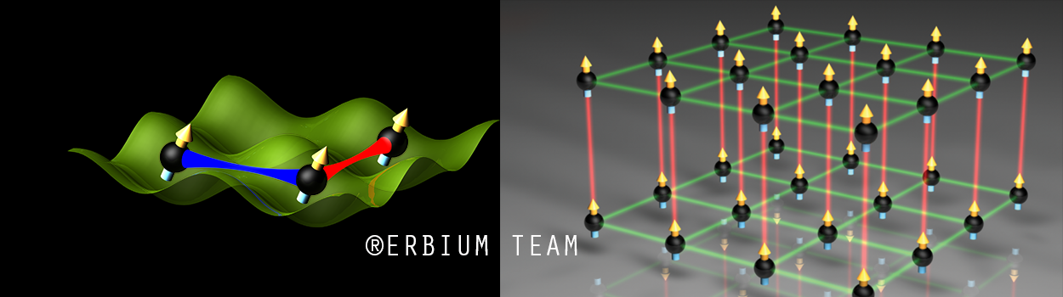
My plan for a quantum physics and quantum engineering lab
A few-atom quantum assembler
A quantum gas experiment
IQOQI
JILA

Slide 23
Why erbium?
铒
IQOQI
Only 3 experiments in the world have BEC of erbium (Innsbruck, Bonn, Paris)
It has several stable fermionic and bosonic isotopes with high abundancy (>25%)
It is highly magnetic μ = 7μ_{Β} and thus strongly dipolar
A transition at 401 nm can lead to submicrometer resolution

Slide 24
How can I achieve that at Nankai University
Form a team with strong physics and engineering skills (4-5 team members)
Collaborate with the Nankai teams and former international colleagues
Standard optics lab space (100-200 m²)
Apply actively for (university, national, local) start-up funding (5-10 million RMB)
团队建设，国际合作，基金申请，论文发表
愿与物理学院的老师一起为推进南开科研多做贡献！！！

Slide 25
Thank you!
谢谢！

